Slide 2
W8@Kom 9 Feb 2021
FS4EU collaborative platform USER GUIDE
Nunzia Cito & Karl Presser
CNR - PREMOTEC
Feb 9, 2021

Slide 3
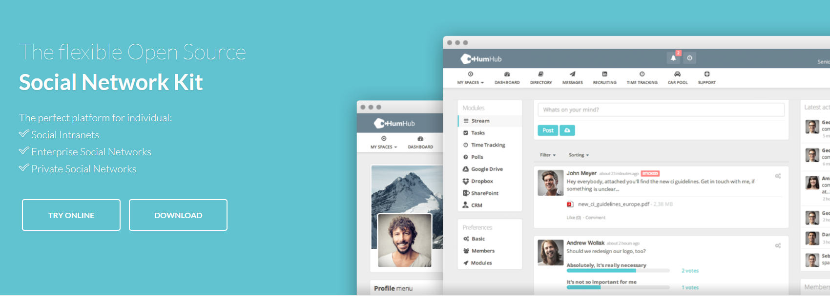
The “FS4EU Collaborative Platform" has been developed in order to provide a powerful tool and working area for sharing information and documents among the Consortium Members and Supporting Partners, and favouring the collaborative work through an easy-to-use web user interface.
The platform is interactive: it should be used to strengthen communication and ensure the transparency of on going tasks and related documents.
This platform has been developed by using the HUMHUB social open source network software and framework. It can be used also on smartphone and tablet.
This tool has several functions to be used and customized according to the project life cycle and the teams needs; it can be updated also with other features, files or modules if needed.
The Platform Administrators are Nunzia Cito and Mimmo Genchi (CNR), supported by Karl Presser (PMT).

Slide 4
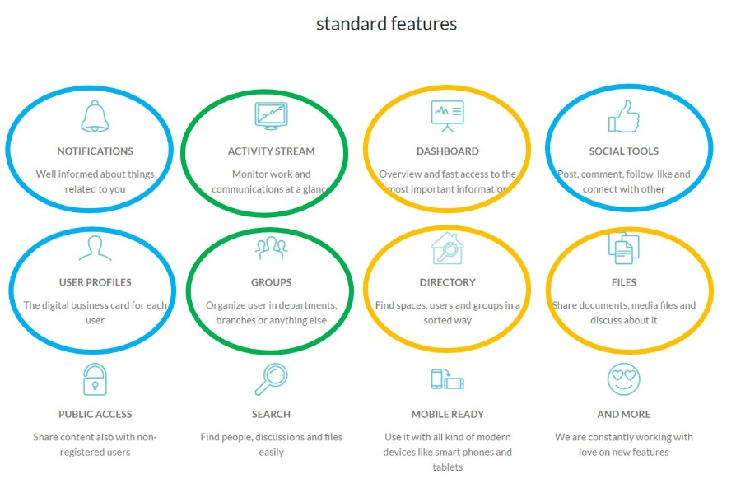
The platform should be used to improve interaction and communication among partners by using the following features:
WORKING features:
DASHBOARD: overview and fast access to the most important information
ACTIVITY STREAM: knowing and monitoring work and communications at a glance
DIRECTORY: organized spaces, users and groups in a sorted way
FILES: organized documents, media files and related discussion
TASKS: assignment of tasks and deadlines to target users
WIKI: co-writing tool

Slide 5
The platform should be used to improve interaction and communication among partners by using the following features:
SOCIAL features:
USER PROFILE
NOTIFICATIONS
SOCIAL TOOLS (post, comment, follow, like and connect with other members)
MEETINGS: scheduling of meetings with agenda and protocols
Jiitsi meet: online meetings
GROUPS: categories of users

Slide 6
In the following slides you can find the main steps to access, explore and use the platform
We will link our Collaborative Platform to the FS4EU website in order to facilitate the login
https://foodsafety4.eu/#welcome

Slide 7
https://fs4eu.humhub.com/user/auth/login
Type your namesurname (i.e. nunziacito)
Password: FS4EU
Sign in
Choose your language

Slide 8
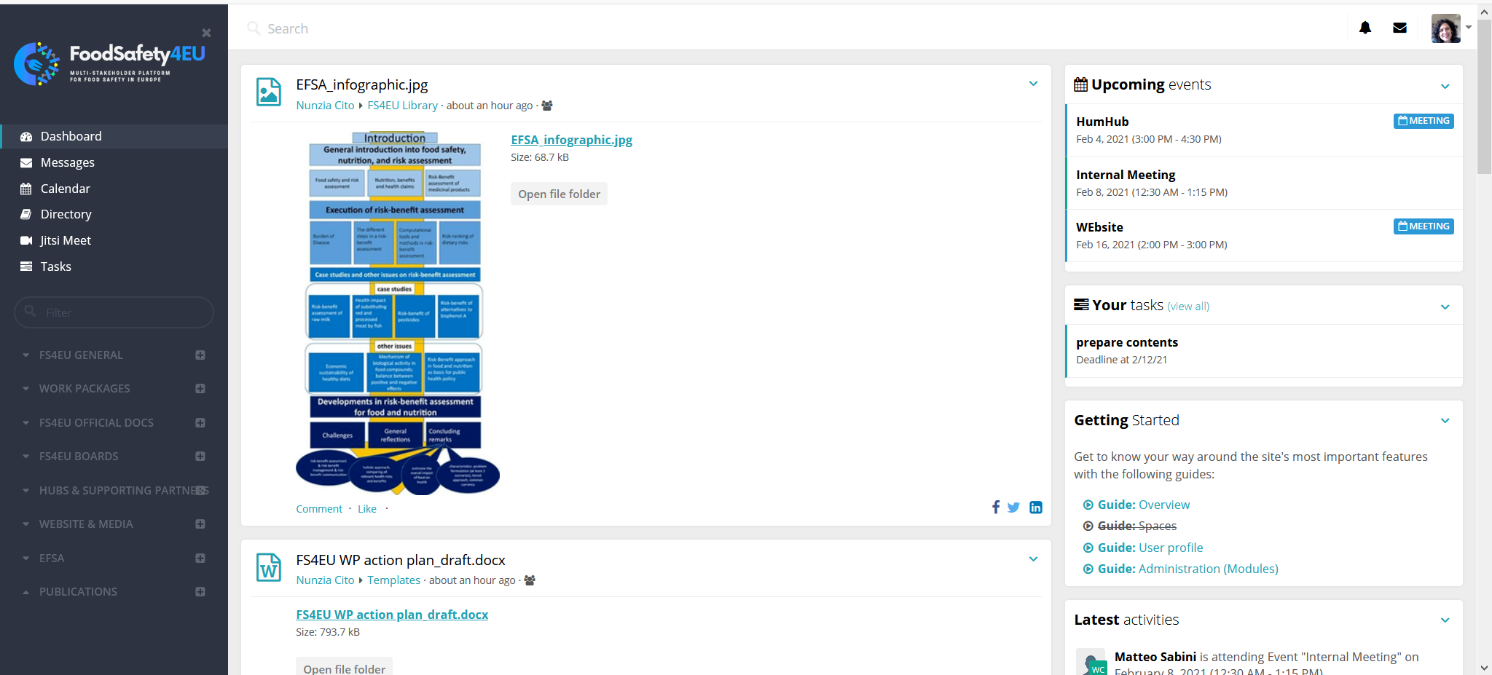
The first screen you can see when logged in is the section DASHBOARD
User profile,
notifications, messages
AREAS/TOOLS for SOCIAL INTERACTION
This is the STREAM:
the default space where you can see all the activities and messages done by members
PERSONAL AREA
WORKING AREA with DIRECTORIES (PRIVATE OR PUBLIC)

Slide 9
You can change your Profile info and Account settings
User profile

Slide 10
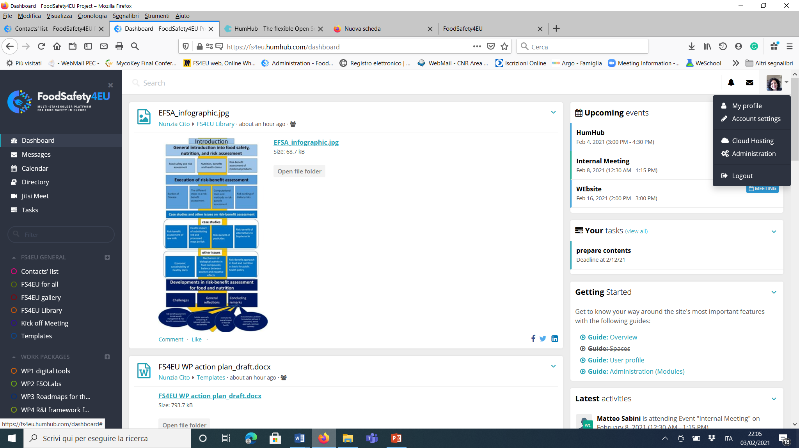
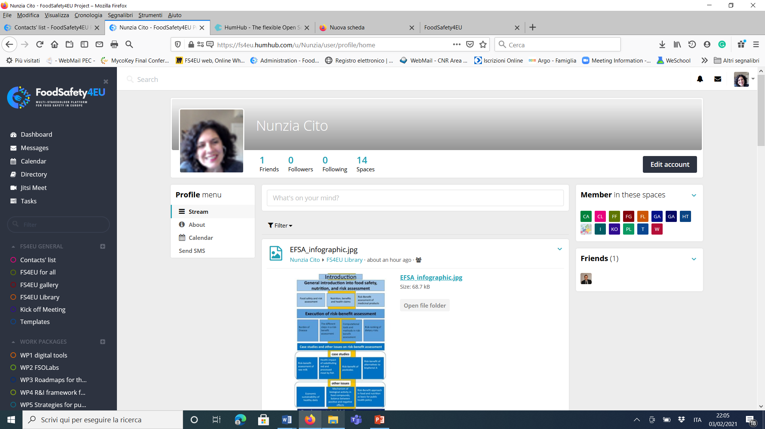
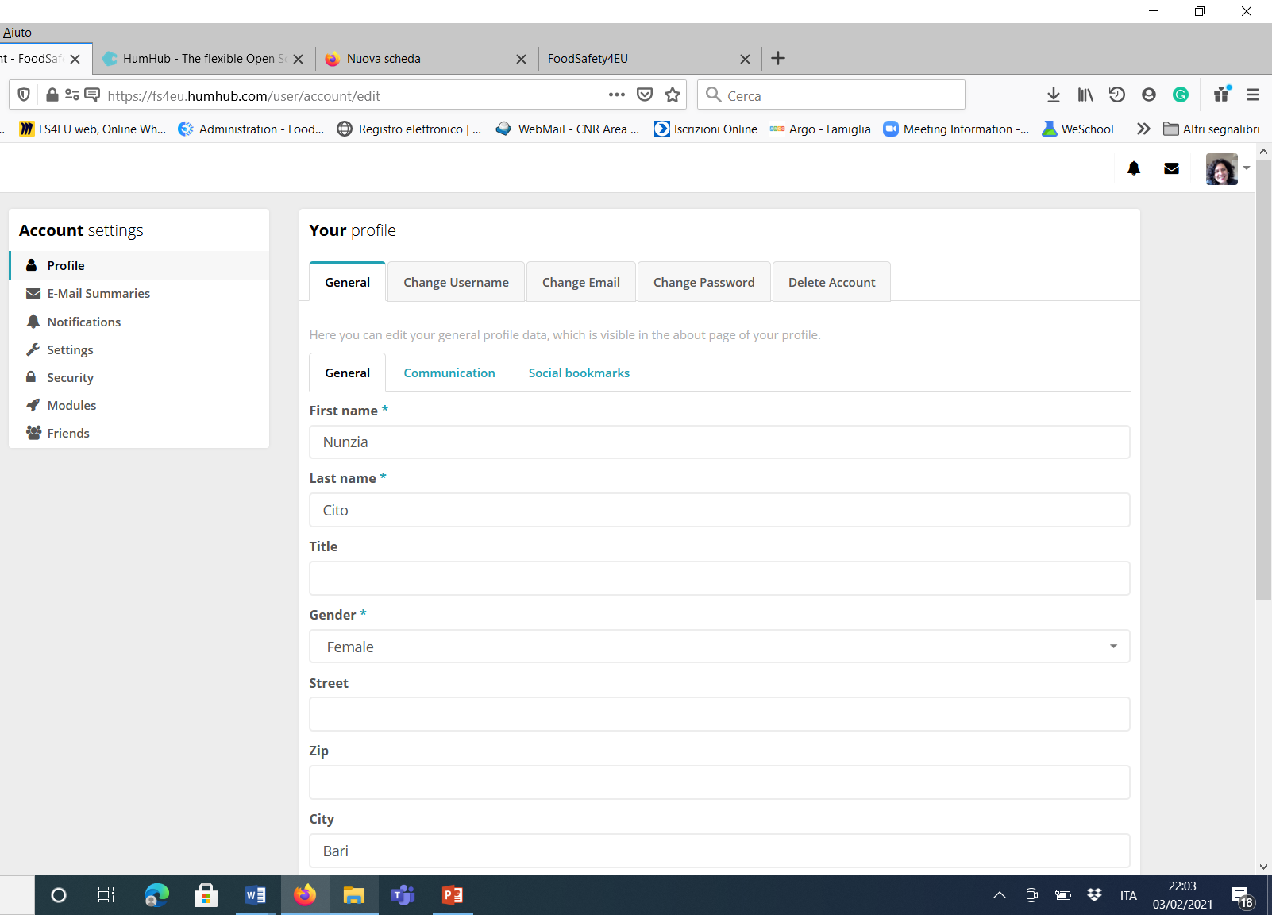
Click on MY PROFILE and then on EDIT ACCOUNT to edit/update your info
You can change and customize functions (i.e. receive daily e-mail summaries, set language, change password, etc.)

Slide 11
Short presentation of section “Directory” (black section on the left)
“FS4EU GENERAL ”: here you can find all the spaces where we can share relevant docs and communicate with all.
This section includes spaces that can be useful for all and for general communication/information by Coordinator.
You can also add any document considered relevant for all the partners by using the space FS4EU for all,
the gallery to share pics, images,
the library to share docs
the KoM slides to find recordings links and presentations used during the KoM.
“WORK PACKAGES”: you will see the WPs directories with spaces you’re involved in.
The WP leaders are in charge of managing the spaces, by feeding the stream, uploading the files in the “files” menu, sending messages and spread communication. Here you can use any module you need, such as MEETINGS, POLLS, WIKI, TASKS, according to your needs, and create additional spaces to organize your work.

Slide 12
Short presentation of section “Directory” (black section on the left)
“FS4EU OFFICIAL DOCS ”: here you can find all documents organized in the spaces for categories, accoring to their purpose and use.
“FS4EU BOARDS”: these are spaces dedicated to the project’s boards management, to be used for preparing the meetings, write and share the minutes, discuss any issue. You will see the spaces you’re involved in (i.e. all the partners are members of the GENERAL ASSEMBLY space, while WP leaders and Co-leaders are members of the Executive Comittee space).
“HUBS and SUPPORTING PARTNERS”: these are spaces dedicated to the project’s hubs organization and management. You will see the spaces you’re involved in.
OPEN SCIENCE: you will find all the FS4EU publications organized per WP and useful files for the OPEN DATA management.
EFSA: this is the potential space to interact with EFSA (to be confirmed).

Slide 13
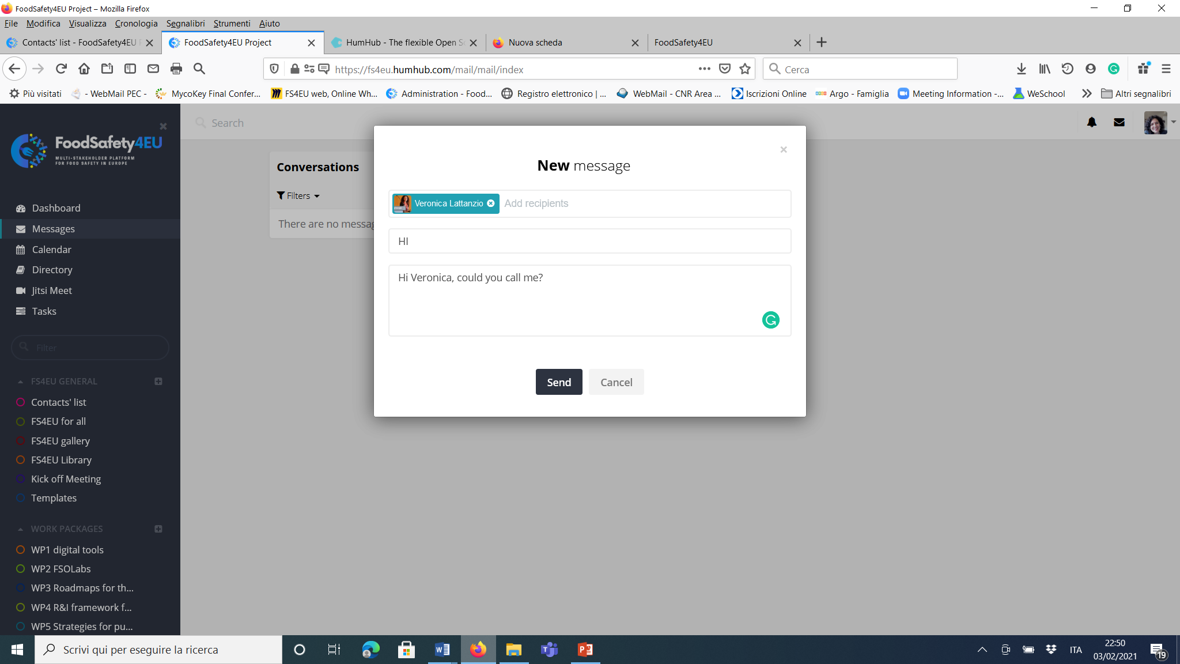
Now let’s move to MESSAGES section
You can send a message (files, etc) to one or more members (add users) who will receive a notification in his/her box. Members can track record of conversations
Use this module for messages to individuals/ few members
(while use the dashboard to message all the members of your WP/ space

Slide 14
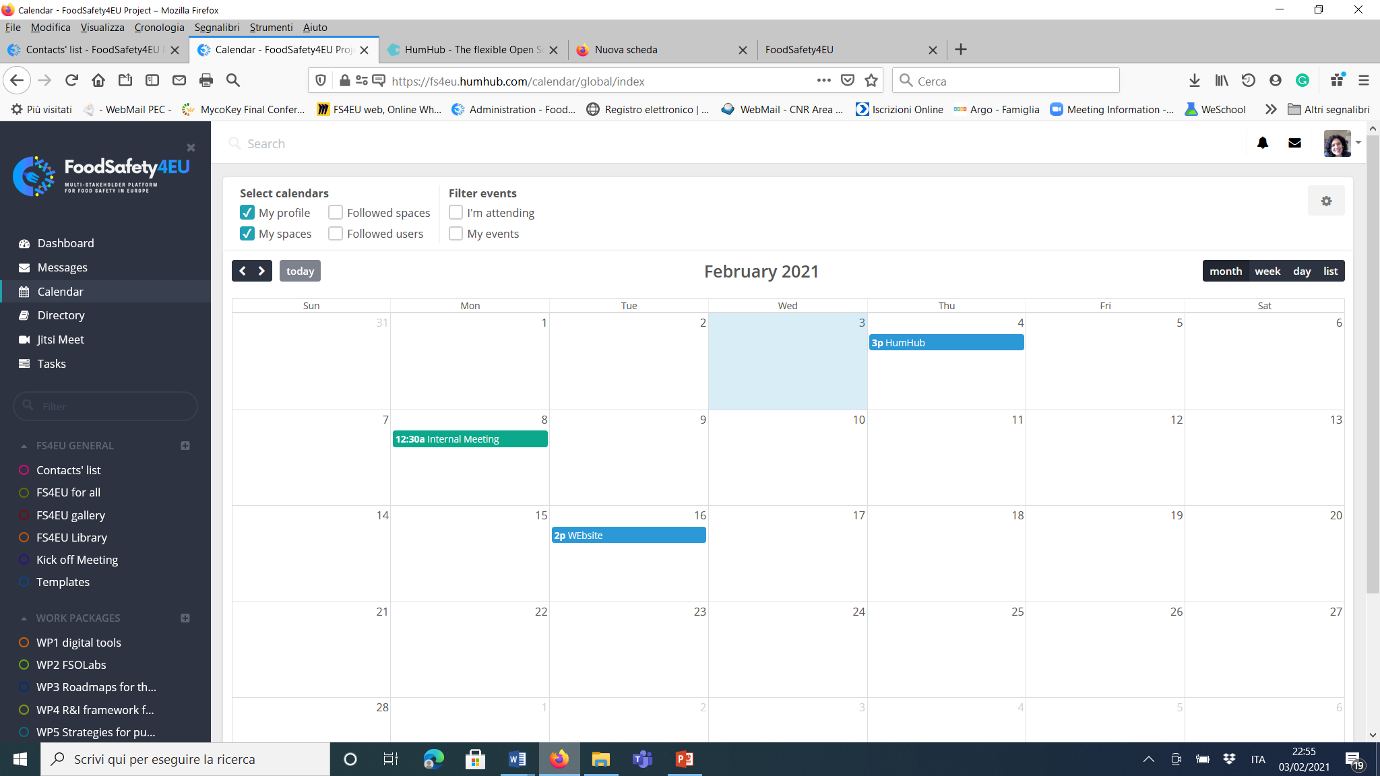
Now let’s move to CALENDAR
You can display here the meetings and events you’re involved in.
Select any calendar you need, by using the filters.

Slide 15
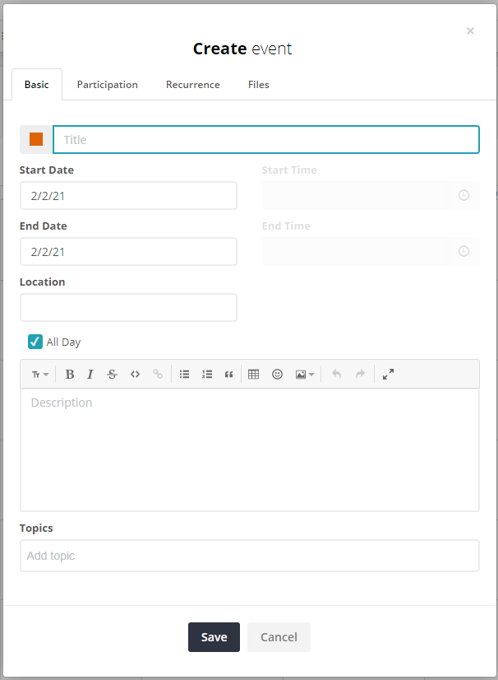
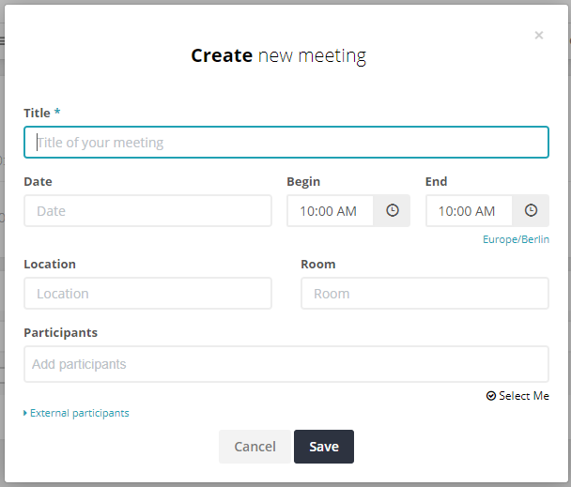
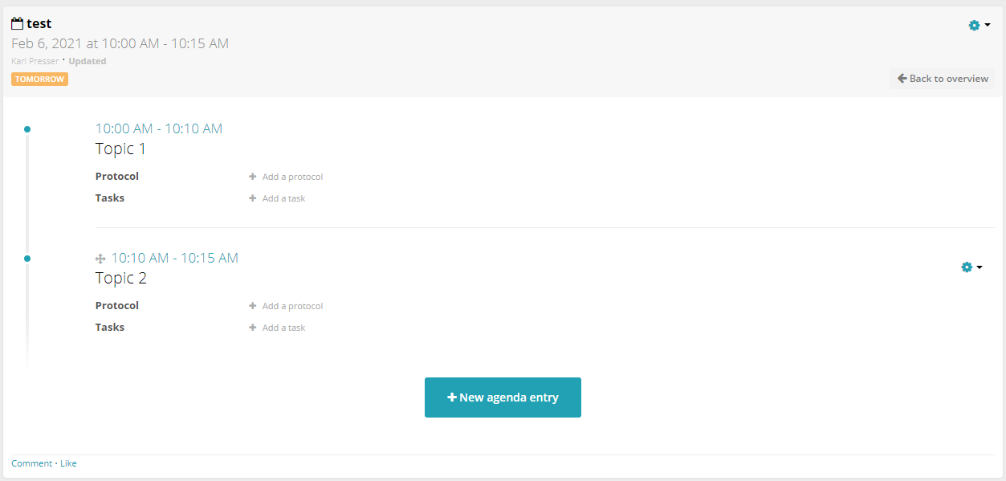
Difference between event and meeting
A meeting is an advanced calendar entry. It can include:
Agenda
Minutes (Protocol) you can assign task before/after the meeting
Use this entry for FS4EU meetings.
An event is similar to a normal calendar entry.
Use this one for conferences and general events outside FS4EU.

Slide 16
Personal calendar and common calendar
Primary calendar is your personal calendar
Invitation should first go by e-mail to person
Additionally, a calendar entry can be done in HumHub
The advantage is that HumHub provides us a common calendar with all WP meetings and external events

Slide 17
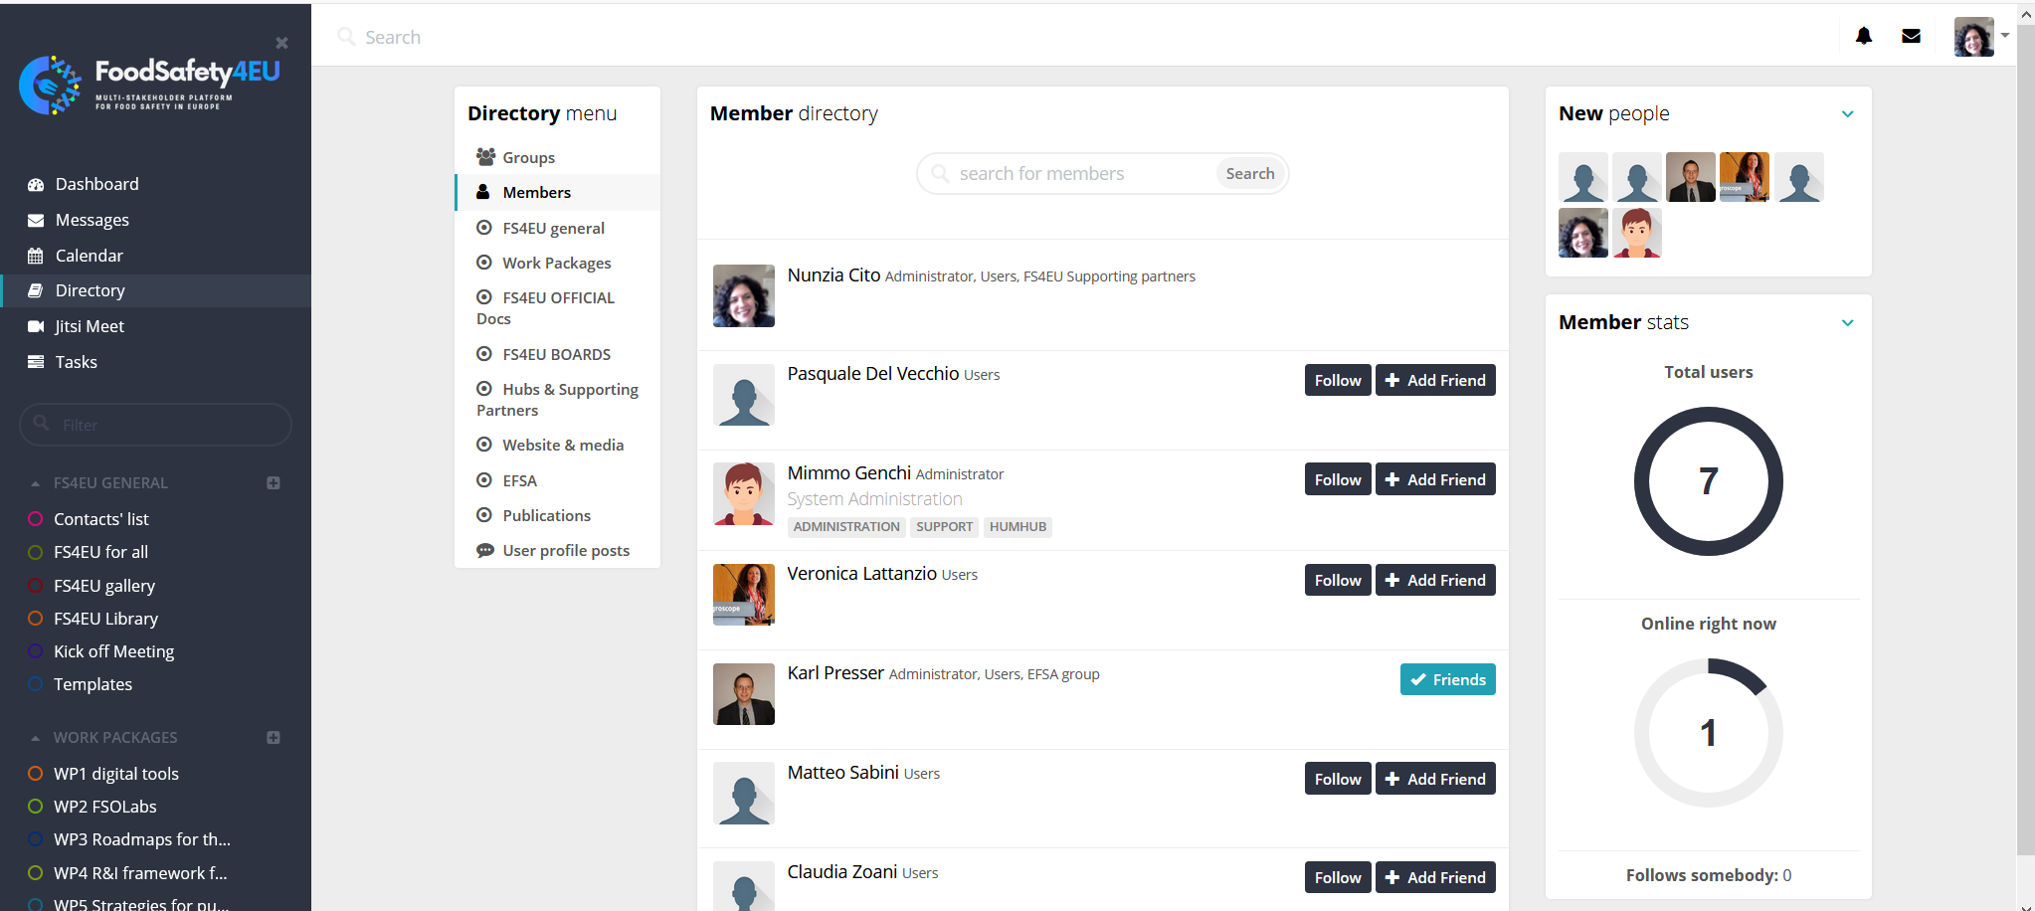
Let’s move to the section DIRECTORY
You can see all the directories and their details (i.e. members)
You should click on the icons to follow a member and/or become friend ☺

Slide 18
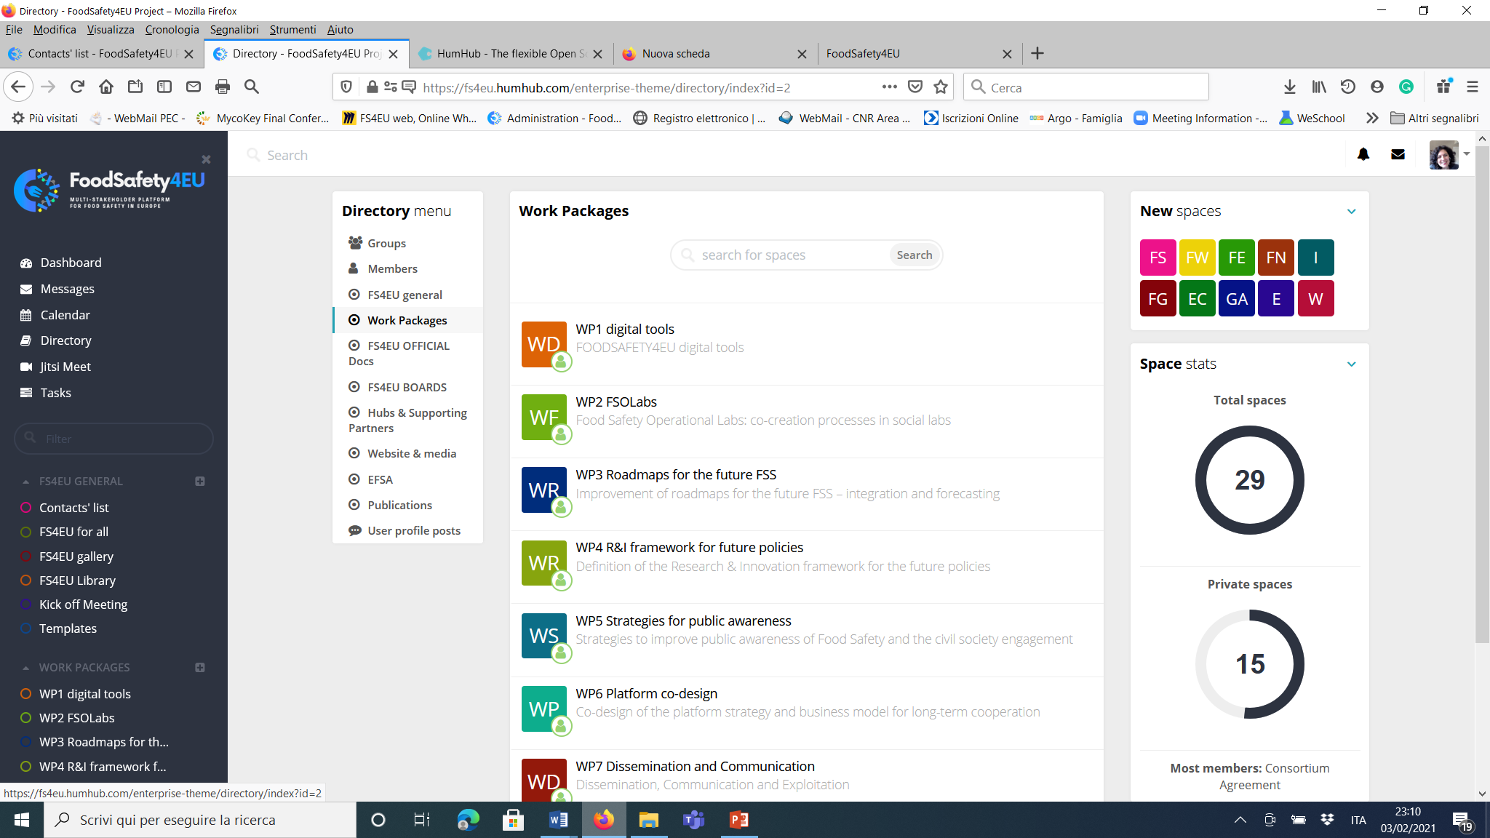
Click on Work Packages and you can see your enabled spaces
You can see the spaces you’ve been enabled to join

Slide 19
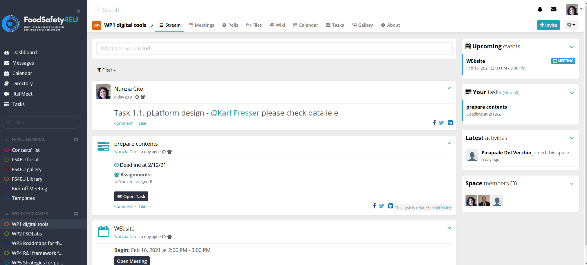
Click on a WP to select a SPACE (i.e. in this screenshot WP1) and you can see and manage activities, members, STREAM, TASKS, and FILES
Modules
write
You can write a post in the stream, upload files and comment.
USE the MODULES to interact in this space with the members of this WP
space.

Slide 20
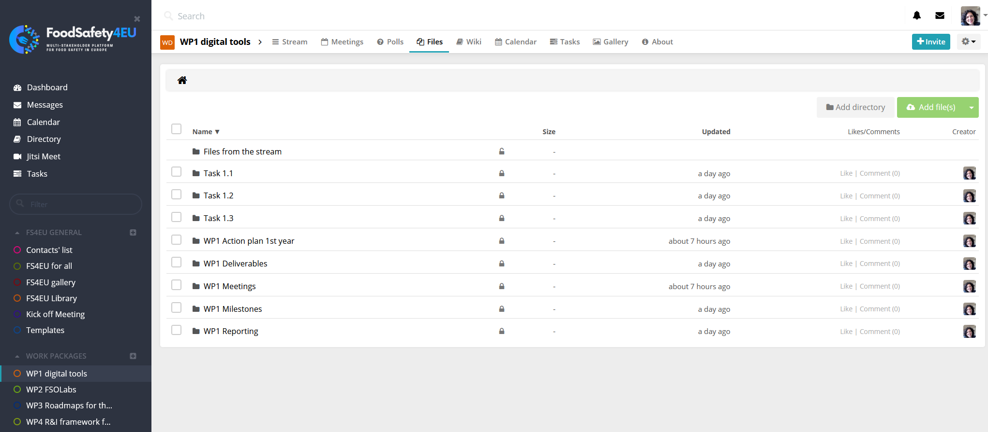
Click on FILES (a) to create a directory, add a directory and/or upload files(b).
a
b
Files not uploaded in a specific directory (uploaded in the stream or in a comment)
This breakdown structure (report, WP files, Deliverable, etc.) is common per each WP. You can add additional directories if needed.

Slide 21
HOW to join a space and become member?
We prepared a defined scheme of spaces and groups of members included in a space (i.e. WP)
When you’re added to a space you will receive a notification. Check always the NOTIFICATION BELL (on the right, upper side) and accept any invitation you will receive to join a space
You could also ask your WP leader/Nunzia to join a space you’re interested in
When you accept the invitation, you will join the selected space, and see the new space in your black section
Now you’re a member of the selected space

Slide 22
When finish your session, click on LOGOUT to leave the platform

Slide 23
Do you have any question,
please contact Nunzia by using the message tool
(click on «new message» and type «nunzia cito»). I’ll try to answer (!) with the gentle support of Mimmo and Karl ☺

